Slide 1
Threads, MUTEX & Semaphores

Slide 2
Threads

Slide 3
Introduction
In the traditional Unix model, when a process needs something
performed by another entity, it forks a child process. There are
problems with a fork:
Fork is expensive. Memory is copied from the parent to the child,
all the descriptors are duplicated in the child. Current implementation
use a technique called copy-on-write, which avoids a copy of the
parent’s data space to the child until the child needs its own copy.
Inter process communication is required to pass information
between the parent and child after the fork.
2. Threads help with both problems. Threads are sometimes called
lightweight processes. That is a thread creation can be 10-100 times
faster than process creation time.

Slide 4
Threads and processes
All threads within a process share the same global memory. This
makes the sharing of information easy between the threads, but
along with this simplicity comes the problem of synchronization.
All threads within a process share:
Process instructions
Most data
Open files (e.g. descriptors)
Signal handlers
Current working directory
User and group Ids

Slide 5
Threads and processes
But each thread has its own:
Thread ID
Set of registers, including program counter and stack pointer
Stack (for local variables and return addresses)
Errno
Signal mask
Priority

Slide 6
Thread Usage Reasons
Simplifying programming model by decomposing application into quasi-parallel threads.
Thread creation is up to 100 times faster than process creation.
Performance is better when there is I/O besides CPU bursts. Overlapping those activities speed up application.
Threads are useful on multiple CPUs systems, where real parallelism is possible.

Slide 7
pthread Library
Linux implements the POSIX standard thread API (known as pthreads). All thread functions and data types are declared in the header file <pthread.h>.
The pthread functions are not included in the standard C library. Instead, they are in libpthread, so you should add -lpthread to the command line when you link your program.

Slide 8
pthread_create
When a program is started by exec, a single thread is created, called
the initial thread or main thread. Additional threads are created by
pthread_create.
#include <pthread.h>
int pthread_create(pthread_t *tid, const pthread_attr_t *attr,
void *(*func) (void *), void *arg);
Returns 0 if OK, positive Exxx value on Error
Each thread within a process is identified by a thread ID, whose
data type is pthread_t. On successful creation of a new thread, its ID
is returned through the pointer tid.

Slide 9
Thread Creation
Each thread has numerous attributes: its priority, its initial stack size,
whether it should be daemon thread or not, and so on. When a thread
is created, we can specify these attributes by initializing a
pthread_attr_t variable that overrides the default. We normally take
the default, we specify the attr argument as a null pointer.
When we create a thread, we specify a function for it to execute,
called its thread start function. The thread starts by calling this
function and then terminates either explicitly (by calling
pthread_exit) or implicitly (by letting this function return).
The address of the function is specified as the func argument, and
this function is called with a single pointer argument, arg.

Slide 10
pthread_join
We can wait for a given thread to terminate by calling pthread_join.
Comparing threads to Unix processes, pthread_create is similar to
fork, and pthread_join is similar to waitpid.
#include <pthread.h>
int pthread_join(pthread_t tid, void **status);
Returns 0 if OK, positive Exxx value on error

Slide 11
pthread_self
Each thread has an ID that defines it with in a given process. The
thread ID is returned by pthread_create. A thread fetches this value
for itself using pthread_self.
#include <pthread.h>
pthread_t pthread_self(void);
Returns thread ID of calling thread

Slide 12
pthread_exit
One way for a thread to terminate is to call pthread_exit.
#include <pthread.h>
void pthread_exit(void *status);
Does not return to caller
If the thread is not detached, its thread ID and exit status are
Retained for a later pthread_join by some other thread
in the calling process.

Slide 13
Thread Attributes
Thread attributes provide a mechanism for fine-tuning the behavior
of individual threads.
int pthread_attr_init ( pthread_attr_t *attr ) ;
int pthread_attr_destroy ( pthread_attr_t *attr) ;
int pthread_attr_setdetachstate ( pthread_attr_t *attr,
int detachstate ) ;
int pthread_attr_setschedpolicy (pthread_attr_t *attr, int policy ) ;
int pthread_attr_setschedparam ( pthread_attr_t *attr,
struct sched_param *param);
int pthread_attr_setinheritsched ( pthread_attr_t *attr, int inherit );
Int pthread_attr_setscope ( pthread_attr_t *attr , int scope );

Slide 14
Cancellation
int pthread_cancel ( pthread_t thread ) ;
int pthread_setcancelstate ( int state , int *oldstate ) ;
int pthread_setcanceltype ( int type , int *oldtype ) ;
void pthread_testcancel ( void ) ;
Cancellation is the mechanism by which a thread can terminate
the execution of another thread . More precisely a thread can send
cancellation request to another thread. Depending on its setting
the target thread can then either ignore the request , honor
it immediately or defer it till it reaches a cancellation point.
When a thread eventually honors a cancellation request ,
it performs as if pthread_exit( PTHREAD_CANCEL ) has been
called at that point .

Slide 15
Synchronization and Critical-sections
Multi-threaded programs are concurrent and share the same process
space and can access the same data structures.
Threads are scheduled by OS and are executed at random. When
threads are executing (racing to complete) they may give unexpected
results (race condition).
Race Condition is a situation in which an unfortunate order of
execution causes undesirable behavior .

Slide 16
Thread Synchronization
The threads library provides three synchronization mechanisms:
  mutexes - Mutual exclusion lock: Block access to variables by other threads. This enforces exclusive access by a thread to a variable or set of variables.
  joins - Make a thread wait till others are complete (terminated).
  condition variables - data type pthread_cond_t
  Waking and Suspending threads (RTL)

Slide 17
Joins
A join is performed when one wants to wait for a thread to finish.
A thread calling routine may launch multiple threads then wait for
them to finish to get the results. One wait for the completion of the
threads with a join.
int pthread_join ( pthread th , void **thread_return ) ;

Slide 18
POSIX SEMAPHORES
A semaphore is a counter that can be used to synchronize multiple
threads. Linux guarantees that checking or modifying the value of
a semaphore can be done safely, without creating a race condition.
Each semaphore has a counter value, which is a non-negative integer.
A semaphore supports two basic operations:
A wait operation decrements the value of the semaphore by 1. If
the value is already zero, the operation blocks until the value of the
semaphore becomes positive.When the semaphore’s value becomes
positive, it is decremented by 1 and the wait operation returns.

Slide 19
….POSIX SEMAPHORES
A post operation increments the value of the semaphore by 1. If the
semaphore was previously zero and other threads are blocked in a
wait operation on that semaphore, one of those threads is unblocked
and its wait operation completes.

Slide 20
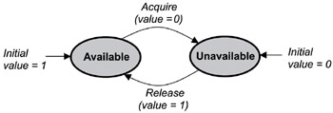
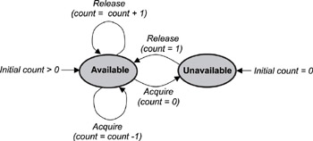
SEMAPHORES
The state diagram of a counting semaphore
The state diagram of a binary semaphore.

Slide 21
….POSIX SEMAPHORES
#include < semaphore .h >
int sem_init ( sem_t *sem , int pshared, unsigned int val ) ;
int sem_wait ( sem_t *sem ) ;
int sem_trywait ( sem_t *sem ) ;
int sem_post ( sem_t *sem ) ;
int sem_getvalue ( sem_t *sem , int *sval ) ;
int sem_destroy ( sem_t *sem ) ;

Slide 22
POSIX Mutexes
A mutex is a MUTual EXclusion device, and is useful for
protecting shared data structures from concurrent modifications,
and implementing critical sections.
A mutex has two possible states: unlocked (not owned by any
thread), and locked (owned by one thread).
#include < pthread .h >
int pthread_mutex_init ( pthread_mutex_t *mutex,
const pthread_mutex attr_t *mutexattr ) ;
int pthread_mutex_lock ( pthread_mutex_t *mutex );
int pthread_mutex_unlock (pthread_mutex_t *mutex);
int pthread_mutex_destroy (pthread_mutex_t *mutex);
int pthread_trylock ( pthread_mutex_t *mutex ) ;

Slide 23
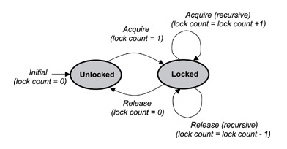
POSIX Mutexes

Slide 24
pthread_mutex_init()
The mutex variable should be declared and initialized only once as
given below:
pthread_mutex_t mutex;
pthread_mutex_init (&mutex, NULL);
Another way to create a mutex with default attributes is to initialize
it with the special value PTHREAD_MUTEX_INITIALIZER.
No additional call to pthread_mutex_init is necessary.
pthread_mutex_t mutex = PTHREAD_MUTEX_INITIALIZER;

Slide 25
pthread_mutex_lock()
A shared global variable x can be protected by a mutex as follows:
int x;
pthread_mutex_t mut = PTHREAD_MUTEX_INITIALIZER;
All accesses and modifications to x should be bracketed by calls to
pthread_mutex_lock and pthread_mutex_unlock as follows:
pthread_mutex_lock(&mut);
/* operate on x */
pthread_mutex_unlock(&mut);

Slide 26
Deadlocks
Deadlocks can occur when two (or more) threads are each blocked,
waiting for a condition to occur that only the other one can cause.
For instance, if thread A is blocked on a condition variable waiting
for thread B to signal it, and thread B is blocked on a condition
variable waiting for thread A to signal it, a deadlock has occurred
Because neither thread will ever signal the other.
You should take care to avoid the possibility of such situations
because they are quite difficult to detect.

Slide 27
Deadlocks
Semaphores can also result in deadlocks. Assume two tasks share
two resources and lock them in different orders. One task (Task B)
locks the first resource using semaphore S1. Then, in the ordinary
course of events a second task (Task A) runs and locks the second
resource with semaphore S2. It needs to use the first resource (S1),
but cannot because it is locked by the first task (Task B). All it can do is pass control back to the first task (Task B), which then attempts to use the second resource (S2). It cannot use it because the second task (Task A) has locked it, so it passes control back to the second resource. But the second resource cannot run, so it passes control back to the first task, endlessly. The two tasks are deadlocked because each is waiting on a semaphore locked by the other task.

Slide 28
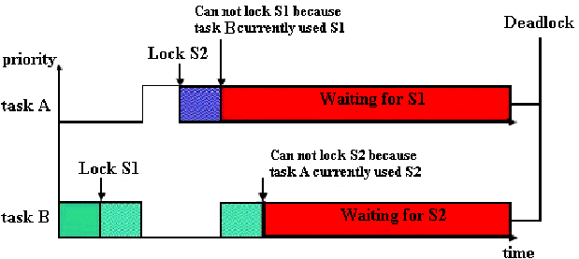
Two tasks reaching deadlock

